Slide 1
Air quality analysis and prediction in tamil nadu
DOMAIN: Data Science

Slide 2
AGENDA
Introduction
Current Air Quality Situation in Tamil Nadu
​Air Quality Data Collection and Analysis
​Health Impacts and Mitigation Strategies
Air Quality Prediction and Forecasting

Slide 3
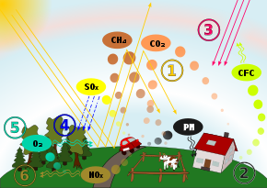
introduction
“Air Quality Analysis and Prediction in Tamil Nadu” refers to the assessment of current air quality conditions and the use of data and models to forecast future air quality in the region. This process involves monitoring pollutants, analyzing their impact on health and the environment, and implementing measures to mitigate pollution, ultimately aiming to safeguard public well-being and environmental quality

Slide 4
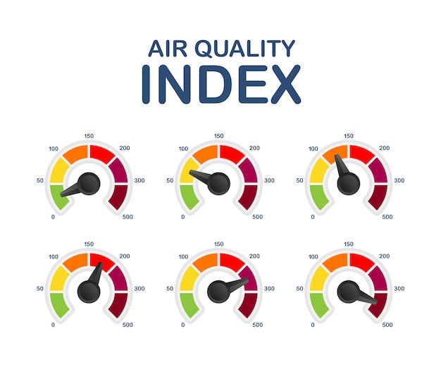
Current Air Quality Situation in Tamil Nadu
The current air quality situation in Tamil Nadu presents a complex landscape influenced by both natural and anthropogenic factors. The state's unique geography and climate can exacerbate pollution levels, especially in urban areas. Monitoring stations across Tamil Nadu consistently measure pollutants like PM2.5, NO2, SO2, CO, O3, and VOCs, providing real-time data on air quality. Recent trends indicate fluctuations in pollution levels, with localized areas of concern. Understanding and addressing these dynamics are crucial for effective air quality management in the region.

Slide 5
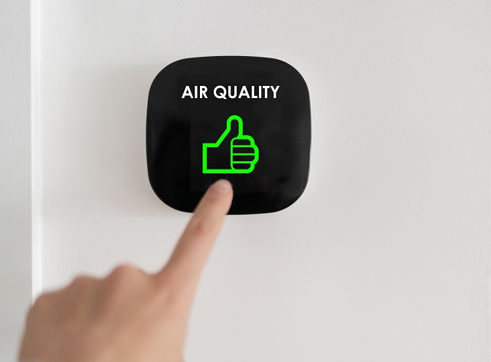
Air Quality Data Collection and Analysis
Air quality data collection and analysis are fundamental components of understanding, managing, and improving air quality in Tamil Nadu. This section provides an in-depth look at the methods, technologies, and processes involved in the collection and analysis of air quality data in the region.

Slide 6
Health Impacts and Mitigation Strategies
Health Impacts of Poor Air Quality
Air pollution in Tamil Nadu, like many other regions, poses significant health risks to its residents. Exposure to polluted air can lead to a range of adverse health effects, including:
Respiratory Problems: High levels of pollutants like PM2.5 and PM10 can penetrate deep into the lungs, causing or exacerbating respiratory conditions such as asthma, bronchitis, and lung infections.
Cardiovascular Diseases: Air pollution is linked to an increased risk of heart attacks, strokes, and other cardiovascular diseases due to the inflammation it triggers and its impact on blood vessels.
Mitigation Strategies
To address the health impacts of poor air quality, Tamil Nadu is implementing a range of mitigation strategies, including:
Emission Reduction Measures: Implementing stricter emission standards for industries, vehicles, and power plants to reduce the release of harmful pollutants into the air.
Promotion of Cleaner Technologies: Encouraging the adoption of cleaner and more energy-efficient technologies in industries and transportation.

Slide 7
Air Quality Prediction and Forecasting
Air quality prediction and forecasting are essential tools for managing air quality in Tamil Nadu. These processes involve using advanced models and data analysis to anticipate future air quality conditions. By doing so, authorities and the public can take proactive measures to protect health and the environment.
Air quality prediction models consider factors like weather patterns, pollutant emissions, and historical data to forecast pollution levels. These forecasts help in planning outdoor activities, implementing pollution control measures, and issuing health advisories when air quality is expected to deteriorate. Accurate predictions enable timely responses and contribute to better air quality management in the region

Slide 8
summary
Air quality analysis and prediction in Tamil Nadu play a pivotal role in assessing and managing air pollution. Through data collection, analysis, and forecasting, authorities and the public can stay informed about air quality conditions. This information empowers proactive measures to safeguard public health, reduce emissions, and improve overall air quality. In Tamil Nadu, ongoing efforts in this field are vital for mitigating the impact of air pollution and ensuring a healthier environment for its residents.

Slide 9
THANK YOU
mohanapriyaa3099@gmail.com
nandhinirajesh520@gmail.com
Jegathiswari.k@gmail.com
sushmarajkumar2003@gmail.com

